Slide 1

Lungs Cancer Detection System Using Machine Learning
For TECHNOVA 2k24
By . . .
Sandesh Gajendra Pol
Sushant Bharat Khadake
Irfan Caanso Naikawade

Slide 2
Point to be discussed
01 Problem Statement
02 Our Key Features
03 Project working
04 Market Analysis
05 Related application for Future

Slide 3

Problem Statement
Lack of Early Detection Tools
Resource Constraints and Workload on Healthcare Professionals.
Data Variability and Complexity in Radiological Images
Limited Accessibility to Advanced Technologies
Continuous Learning and Adaptation
Traditional methods have high false positive rates

Slide 4
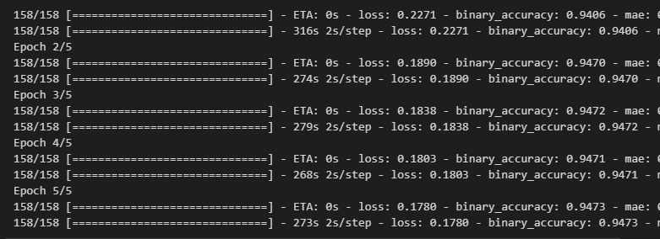
Robust Data Handling
Resource-Efficient Workflow.
Continuous Learning and Improvement.
Automated Early Detection.
User-Friendly Interface
Feature Extraction from Radiological Images
Mobile and Web Accessibility
Cost-Efficient Scalability
Advanced machine learning techniques are employed to handle the variability and complexity inherent in radiological images, ensuring accurate detection across diverse datasets and reducing false positives.
Traditional system cost :
It have the effectiveness of screening method like LDCT , chest X-ray , PTE Scan
But the its very expensive 2000.Rs up-to 50000.Rs .
Our system cost :
Affordable Maintains and operating cost
No other resources
C
Our Features And Solution on Problem
B
A

Slide 5

About Project Technology
Algorithm : Supervised learning
Platform : Web Based Application
Framework: Django (Python Framework)
Dataset : World health organization (WHO)

Slide 6







Working of Project
Match the image pattern with .h5 module treaded module
Load the saved module (.h5)
Give result of prediction in graph form
Get new chest X-ray
( .png format )
Generate report with standard value
Process the image

Slide 7

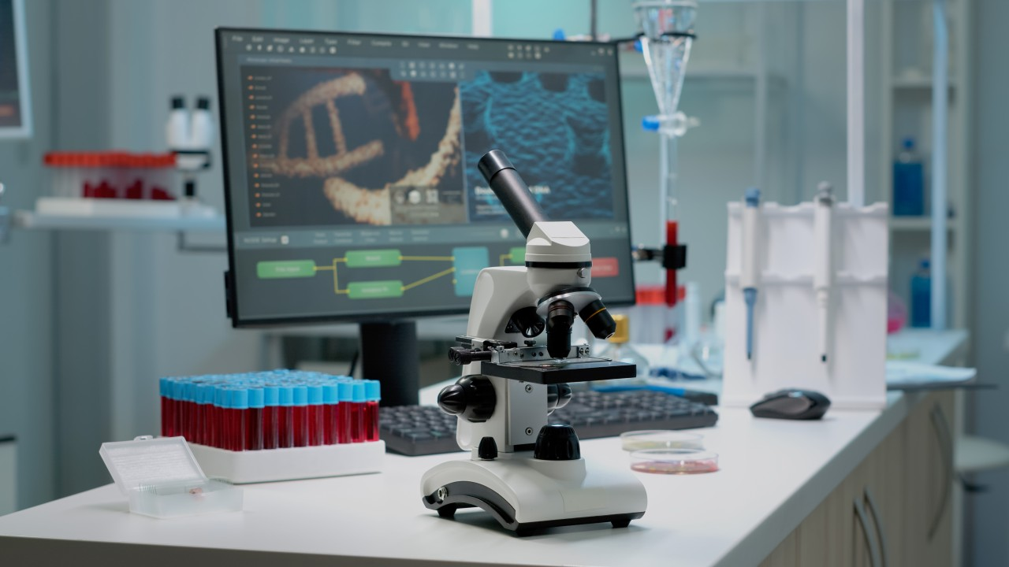


Related Application for business model
Block chain for Secure and Efficient Health Data Sharing
Personalized Cancer Treatment Plans using Genomic Data
Cancer Support Chabot for Patients and Caregivers
Smart Wearable's for Monitoring Cancer Patients

Slide 8
Market Analysis
3. Target Market Segmentation
Institutions (60%),
research institutions and universities (20%),
pharmaceutical companies for clinical trials (10%),
individuals at high risk (10%).
4. Cost Structure:
Research and development costs.
Regulatory compliance expenses.
Marketing and promotional expenses.
Operational costs for ongoing maintenance and support.
Market Overview
Valued at USD 2.61 billion in 2020, it is projected to reach USD 4.85 billion by 2028 (CAGR of 8.1%).
2. Key factors driving growth:
Increasing incidence of lung cancer due to rising smoking population.
Technological advancements in screening techniques.
No Government support for early detection.
Slide references : fortunebusinessinsights.com2 coherentmarketinsights. businessresearchinsights.com

Slide 9

Conclusion
Current condition of lungs cancer treatment in India
This idea will make revolutionary in medical diagnosis because of AI and ML
This is very affordable and time saving idea of early lungs cancer detection and diagnosis

Slide 10

THANK YOU!
Sandesh Pol
Phone:
9067248106
Email:
sandeshpol268@gmail.com

